Slide 1
Module 4.2
Access Control Concepts

Slide 2
Access control
Assumptions
System knows who the user is
Authentication via name and password, other credentials
Access requests pass through gatekeeper (reference monitor)
System must not allow monitor to be bypassed
Reference
monitor
?
Resource
User process
access request
policy

Slide 3
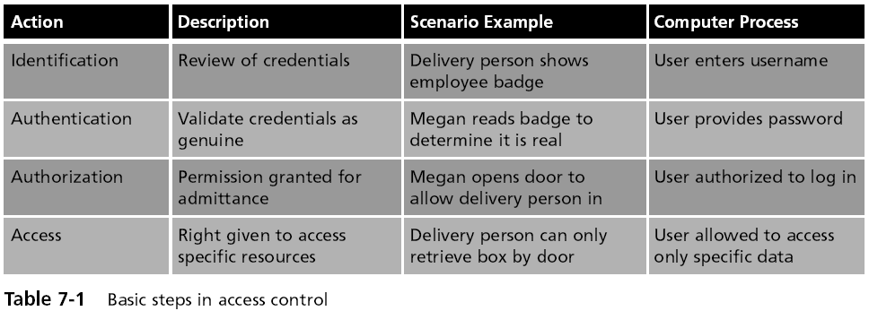
Access Control Terminology (continued)

Slide 4
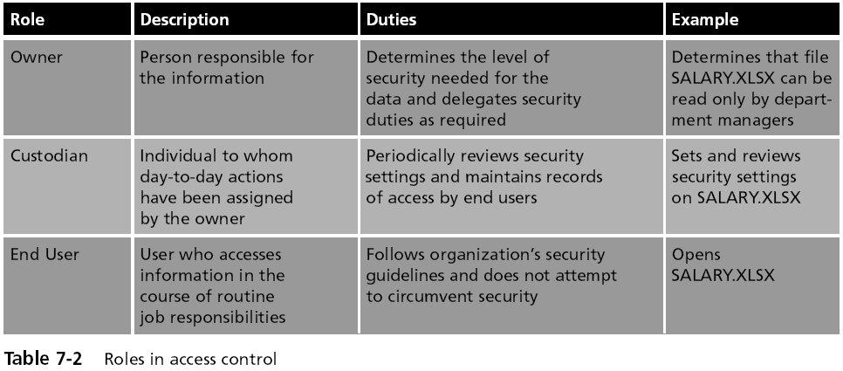
Access Control Terminology

Slide 5
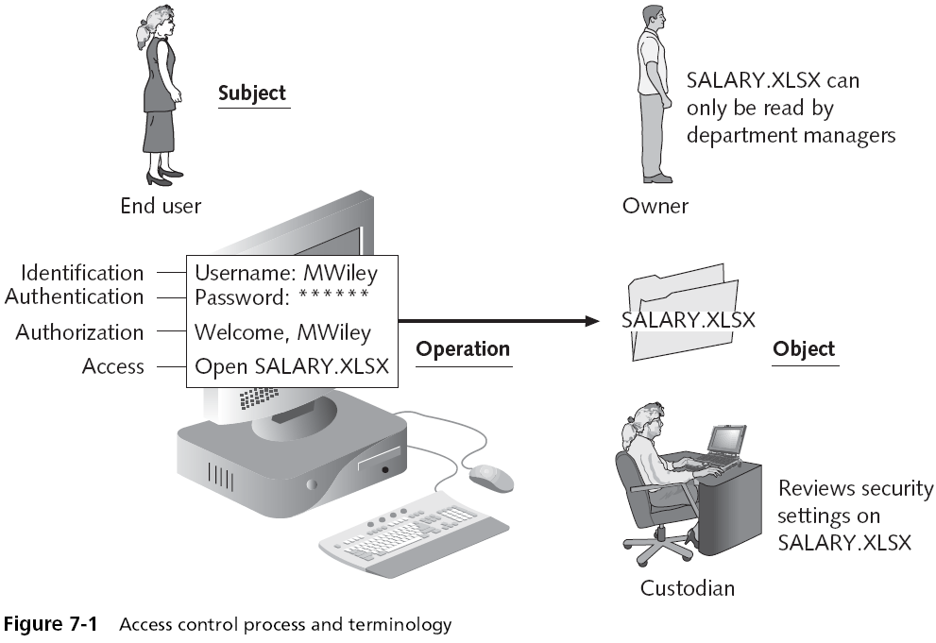

Slide 6
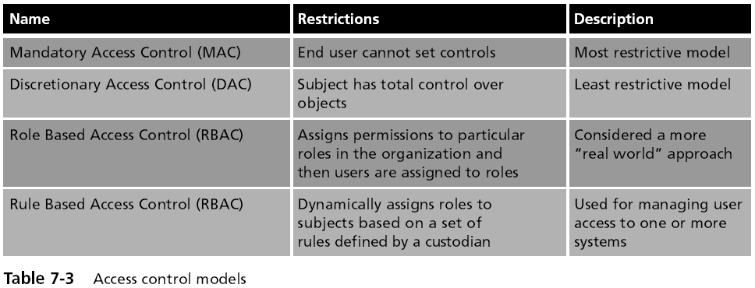
Access Control Models (continued)

Slide 7
Access control matrix [Lampson]
Objects
 | File 1 | File 2 | File 3 | … | File n
User 1 | read | write | - | - | read
User 2 | write | write | write | - | -
User 3 | - | - | - | read | read
…
User m | read | write | read | write | read
Subjects

Slide 8
Implementation concepts
 | File 1 | File 2 | …
User 1 | read | write | -
User 2 | write | write | -
User 3 | - | - | read
…
User m | Read | write | write
Access control list (ACL)
Store column of matrix
with the resource
Capability
User holds a “ticket” for
each resource
Two variations
store row of matrix with user, under OS control
unforgeable ticket in user space
Access control lists are widely used, often with groups
Some aspects of capability concept are used in many systems

Slide 9
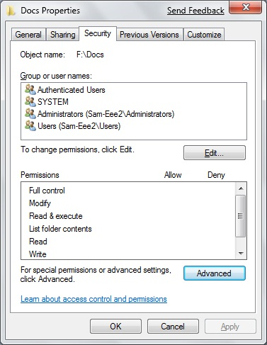
Access Control List (ACL)
A set of permissions attached to an object
Specifies which subjects are allowed to access the object
And what operations they can perform on it
Every file and folder has an ACL
Access control entry (ACE)
Each entry in the ACL table in the Microsoft Windows, Linux, and Mac OS X operating systems

Slide 10
ACL vs Capabilities
Access control list
Associate list with each object
Check user/group against list
Relies on authentication: need to know user
Capabilities
Capability is unforgeable ticket
Random bit sequence, or managed by OS
Can be passed from one process to another
Reference monitor checks ticket
Does not need to know identify of user/process

Slide 11
ACL vs Capabilities
Process P
User U
Process P
Capabilty c,d,e
Process Q
User U
Process Q
Capabilty c,e
Process R
User U
Process R
Capabilty c

Slide 12
ACL vs Capabilities
Delegation
Cap: Process can pass capability at run time
ACL: Try to get owner to add permission to list?
More common: let other process act under current user
Revocation
ACL: Remove user or group from list
Cap: Try to get capability back from process?
Possible in some systems if appropriate bookkeeping
OS knows which data is capability
If capability is used for multiple resources, have to revoke all or none …
Indirection: capability points to pointer to resource
If C → P → R, then revoke capability C by setting P=0

Slide 13
Roles (aka Groups)
Role = set of users
Administrator, PowerUser, User, Guest
Assign permissions to roles; each user gets permission
Role hierarchy
Partial order of roles
Each role gets
permissions of roles below
List only new permissions
given to each role
Administrator
PowerUser
User
Guest

Slide 14
Role-Based Access Control
Individuals
Roles
Resources
engineering
Server 1
marketing
Server 2
Server 3
human res
Advantage: users change more frequently than roles

Slide 15
Access control summary
Access control involves reference monitor
Check permissions: ⟨user info, action⟩→ yes/no
Important: no way around this check
Access control matrix
Access control lists vs capabilities
Advantages and disadvantages of each
Role-based access control
Use group as “user info”; use group hierarchies

